Slide 1
Normalization
Presented By
Md. Zahid Hasan
Zahid.cse@diu.edu.bd

Slide 2
Definition
Normalization is the process of organizing the data in the database.
Normalization is used to minimize the redundancy from a relation or set of relations. It is also used to eliminate the undesirable characteristics like Insertion, Update and Deletion Anomalies.
Normalization divides the larger table into the smaller table and links them using relationship.
The normal form is used to reduce redundancy from the database table

Slide 3
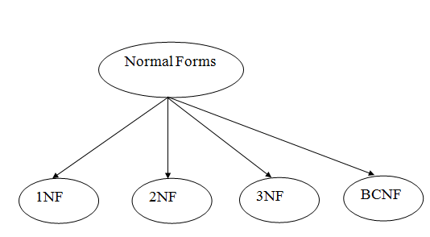
Types of Normal Forms
There are the following four types of normal forms:

Slide 4
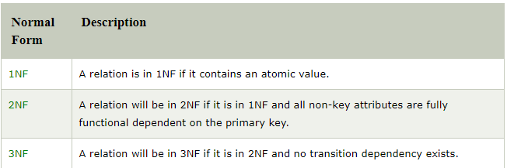
Description of normal form

Slide 5
First Normal Form (1NF)
A relation will be 1NF if it contains an atomic value.
It states that an attribute of a table cannot hold multiple values. It must hold only single-valued attribute.
First normal form disallows the multi-valued attribute, composite attribute, and their combinations.

Slide 6
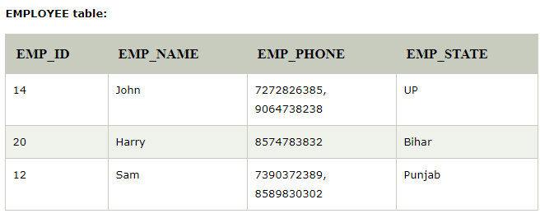
Example of 1NF
Here, Relation EMPLOYEE is not in 1NF because of multi-valued attribute EMP_PHONE.

Slide 7
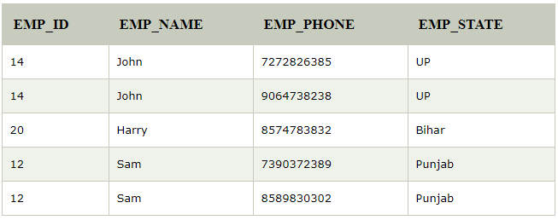
Example of 1NF(Cont’d)
The decomposition of the EMPLOYEE table into 1NF has been shown below:

Slide 8
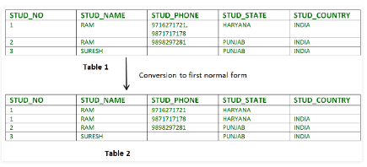
Example of 1NF(Cont’d)
Relation STUDENT in table 1 is not in 1NF because of multi-valued attribute STUD_PHONE. Its decomposition into 1NF has been shown in table 2.

Slide 9
Second Normal Form (2NF)
In the 2NF, relational must be in 1NF.
In the second normal form, this full functional dependency means that it meets the requirements of First Normal Form (1NF), and all non-key attributes are fully functionally dependent on the primary key.
A relation is in 2NF if it has No Partial Dependency
If the proper subset of candidate key determines non-prime attribute, it is called partial dependency.
2NF tries to reduce the redundant data getting stored in memory.

Slide 10
Example of 2NF
Second Normal Form
Before we learn about the second normal form, we need to understand the following −
•Prime attribute − An attribute, which is a part of the candidate-key, is known as a prime attribute.
•Non-prime attribute − An attribute, which is not a part of the prime-key, is said to be a non-prime attribute.
If we follow second normal form, then every non-prime attribute should be fully functionally dependent on prime key attribute.

Slide 11
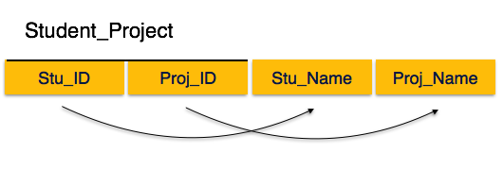
Example of 2NF

Slide 12
Example of 2NF
We see here in Student_Project relation that the prime key attributes are Stu_ID and Proj_ID. According to the rule, non-key attributes, i.e. Stu_Name and Proj_Name must be dependent upon both and not on any of the prime key attribute individually. But we find that Stu_Name can be identified by Stu_ID and Proj_Name can be identified by Proj_ID independently. This is called partial dependency, which is not allowed in Second Normal Form. Partial Dependency means where an attribute in a table depends on only a part of the primary key but not on the whole primary key.

Slide 13
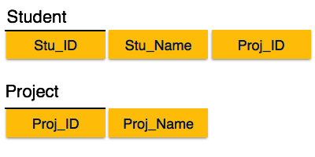
Example of 2NF
We broke the relation in two as depicted in the above picture. So there exists no partial dependency.

Slide 14
Third Normal Form (3NF)
A relation will be in 3NF if it is in 2NF and not contain any transitive partial dependency.
If there is no transitive dependency for non-prime attributes, then the relation must be in third normal form.
A relation is in third normal form if it holds atleast one of the following conditions for every non-trivial function dependency X → Y.
X is a super key.
Y is a prime attribute, i.e., each element of Y is part of some candidate key
A relation is in third normal form, if there is no transitive dependency for non-prime attributes as well as it is in second normal form.
Transitive dependency – If A->B and B->C are two FDs then A->C is called transitive dependency.

Slide 15
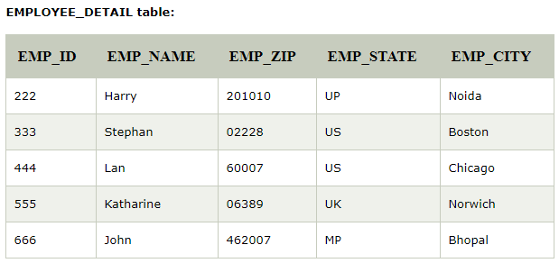
Example of 3NF
Super key in the above table :
{EMP_ID}, {EMP_ID, EMP_NAME}, {EMP_ID, EMP_NAME, EMP_ZIP}....so on
Candidate key: {EMP_ID}

Slide 16
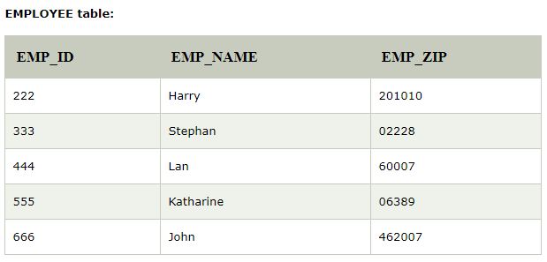
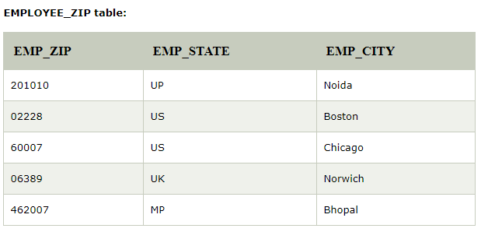
Example of 3NF(Cont’d)
Non-prime attributes: In the given table, all attributes except EMP_ID are non-prime.
Here, EMP_STATE & EMP_CITY dependent on EMP_ZIP and EMP_ZIP dependent on EMP_ID. The non-prime attributes (EMP_STATE, EMP_CITY) transitively dependent on super key(EMP_ID). It violates the rule of third normal form.
That's why we need to move the EMP_CITY and EMP_STATE to the new <EMPLOYEE_ZIP> table, with EMP_ZIP as a Primary key

Slide 17

Example of 3NF(Cont’d)
In relation STUDENT given in Table ,
FD set: {STUD_NO -> STUD_NAME, STUD_NO -> STUD_STATE, STUD_STATE -> STUD_COUNTRY, STUD_NO -> STUD_AGE} Candidate Key: {STUD_NO}
For this relation in given table , STUD_NO -> STUD_STATE and STUD_STATE -> STUD_COUNTRY are true. So STUD_COUNTRY is transitively dependent on STUD_NO. It violates the third normal form.

Slide 18
Example of 3NF(Cont’d)
To convert it in third normal form, we will decompose the relation
STUDENT (STUD_NO, STUD_NAME, STUD_PHONE, STUD_STATE, STUD_COUNTRY_STUD_AGE)
as:
STUDENT (STUD_NO, STUD_NAME, STUD_PHONE, STUD_STATE, STUD_AGE)
STATE_COUNTRY (STATE, COUNTRY)

Slide 19
Boyce-Codd Normal Form (BCNF)
It is an advance version of 3NF that’s why it is also referred as 3.5NF. BCNF is stricter than 3NF. A table complies with BCNF if it is in 3NF and for every functional dependency X->Y, X should be the super key of the table.

Slide 20
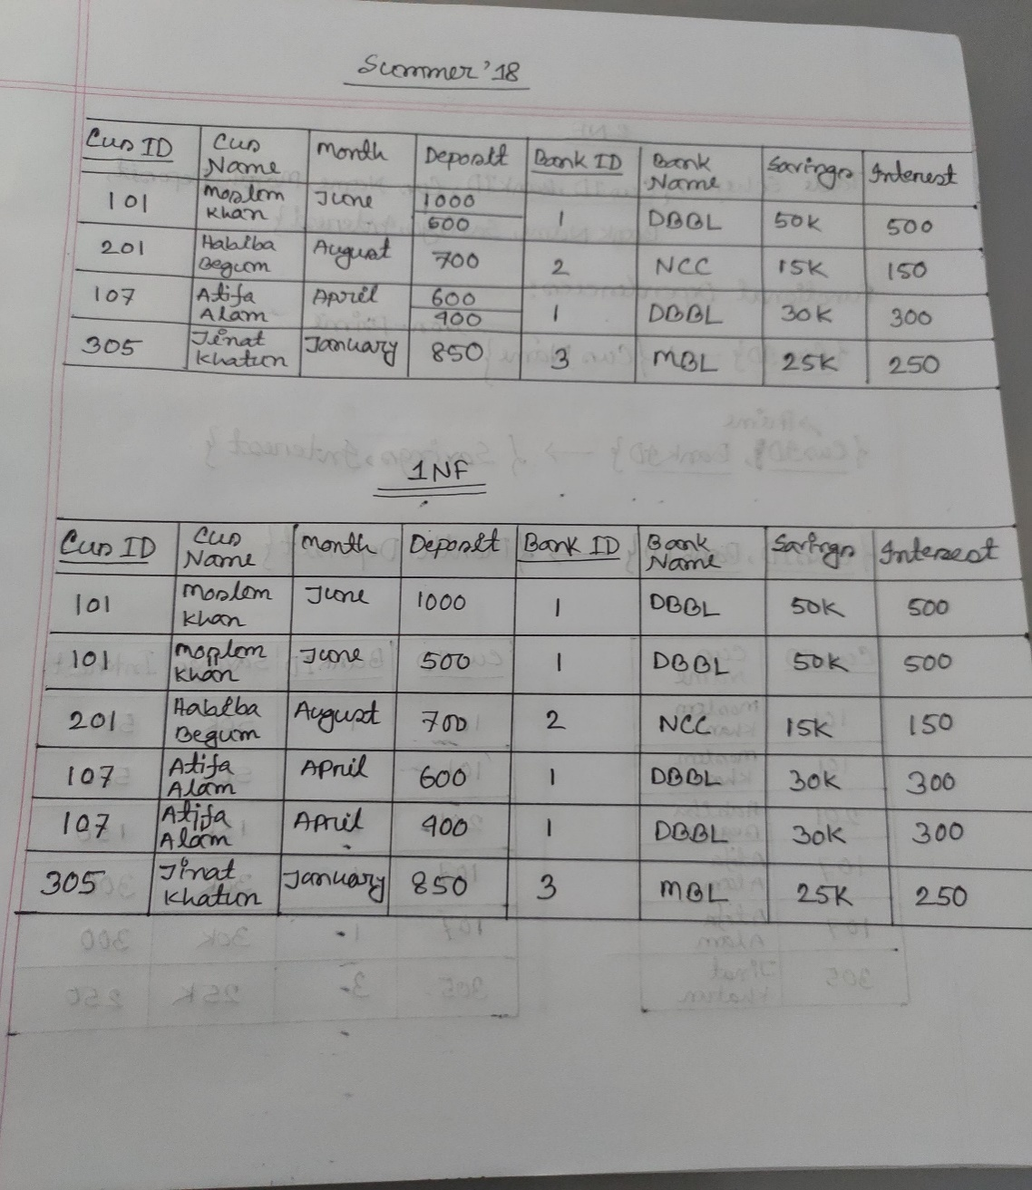
Example of Normalization

Slide 21
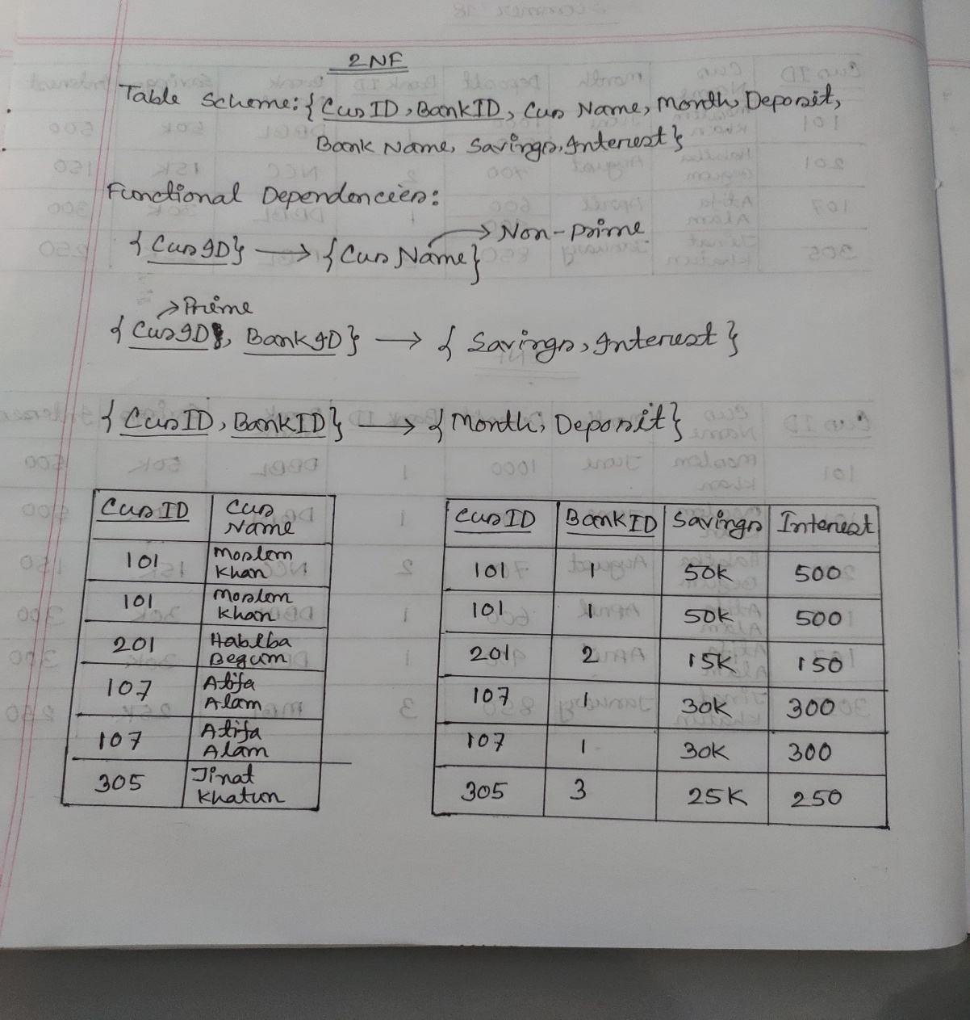
Example of Normalization

Slide 22
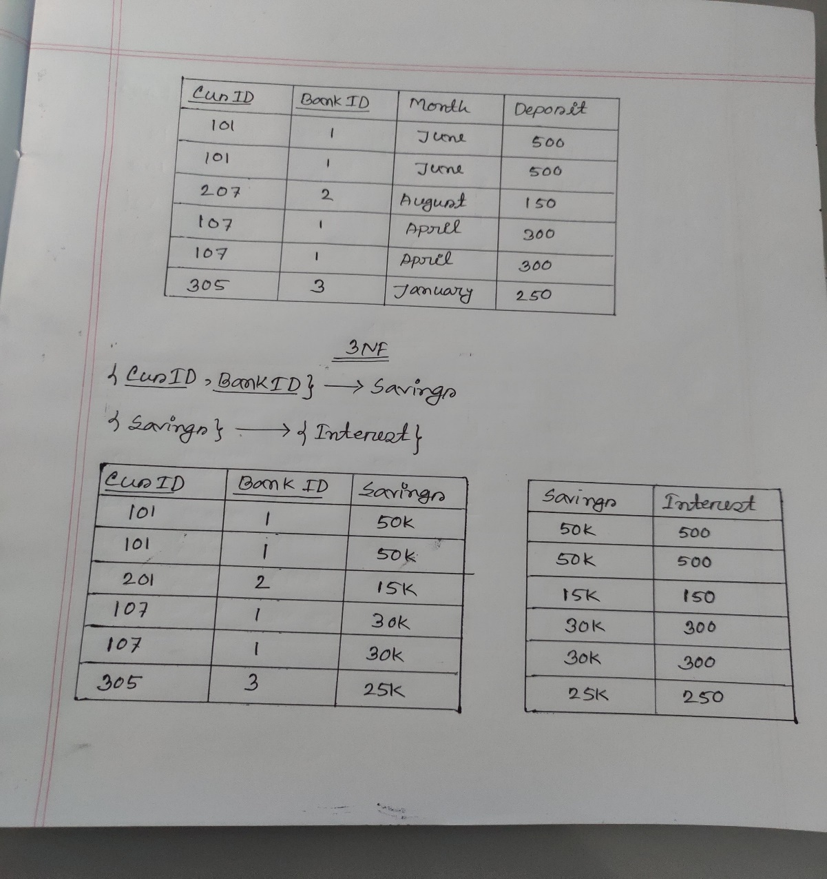
Example of Normalization

Slide 23
“A winner is a dreamer who never gives up”
– Nelson Mandela

